Slide 1

ONLINE BOOK STORE
Done by:
YUVRAJ SINGH WAHLA -20BCS250
SANJANA KUMARI SHARMA-20BCS196
BHUKYA SANJANA RATHOD-20BCS056
Notes:
NOTE:
To change the image on this slide, select the picture and delete it. Then click the Pictures icon in the placeholder to insert your own image.

Slide 2
Overall Description:
The project is based on a book database system pertaining to various needs of the user. The store contains all the books used in specific CSE course. The description and details of the books are also available.
The main Objective of this project is to manage the details of books, customers, orders and transactions. The project is totally built at administrative end and thus only the administrator is guaranteed the access. Students can either buy or rent the books. We built a personal profile page which is used for handling the transactions.

Slide 3
Queries and functionalities:
Students need to login first to search or buy or rent books.
Students can either buy or rent the books. They can add books to cart if they wish to buy it later.
We provide a quick purchase system- as soon as the person clicks the checkout button, a webpage requiring information for payment options opens.
The orders table in the database record all the details of orders.
Admin can login and can add the books or edit the details of the books.

Slide 4
Technology Used:
The project was coded in PHP 5 with database implementation in mysql. The validation of every form is implemented at the client side using JavaScript. We also used bootstrap along with HTML and CSS. Session Variables have been used to maintain data during navigation between different pages.

Slide 5
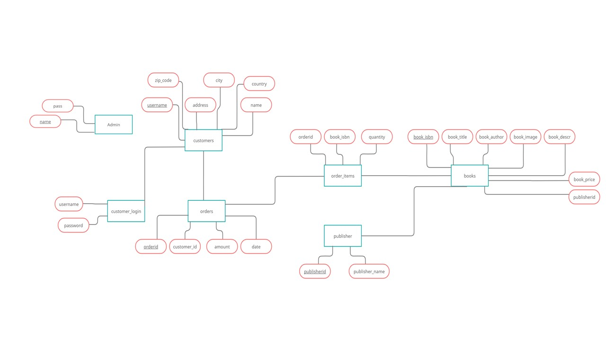
ER-DIAGRAM:

Slide 6
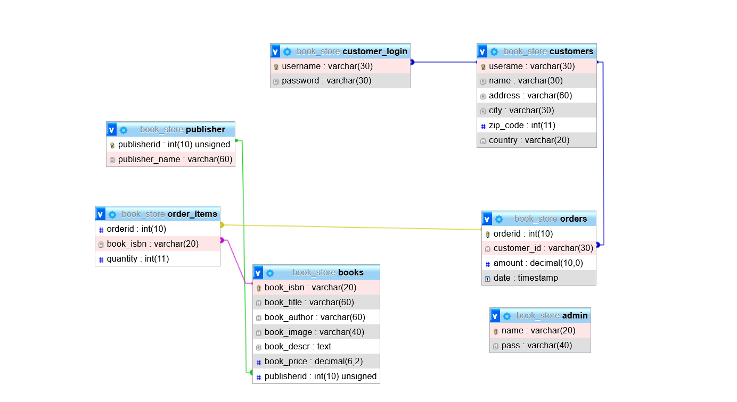
Relational Diagram:

Slide 7
THANKYOU

